Slide 1
Embedding of the flagship
From alignment to implementation

Slide 2
Main points:
First part: Alignment with the flagship in the ETC programmes. A brief oveview
Second part: Embedding during the implementation: focus on the call for proposals

Slide 3
Embedding of the flagship into the Programmes: an overview
Specific Objectives (EDRF) | Programmes | N. of Programmes
SO1.2 - Reaping the benefits of digitalisation for citizens, companies and governments | GR-IT | 1
SO2.4 Promoting climate change adaptation and disaster risk prevention, resilience taking into account eco-system based approaches | ADRION; SLO-HR; GR-AL; GR-IT; IPA HR-SE; IT-HR; IT-SLO; IPA HR-BiH-ME | 8
SO2.5. Promoting access to water and sustainable water management | GR-AL | 1
SO2.7. Enhancing protection and preservation of nature, biodiversity and green infrastructure, including urban areas, and reducing all forms of pollution | ADRION; GR-AL; GR-IT; GR-NM; IPA SOUTH ADRIATIC; IT-HR; IT-SLO (strategic project: POSEIDONE) | 7
ISO1.1 - Enhance the institutional capacity of public authorities, in particular those mandated to manage a specific territory, and all stakeholders | GR-IT | 1
ISO6.6. Other actions to support better cooperation governance (all strands) | IT-HR | 1

Slide 4
Direct reference to ICZM/MSP in the Programmes
ADRION
“Definition of action plans to reinforce the implementation of existing/new Integrated Coastal Zone Management, Maritime Spatial Planning as well as the implementation of the UN Barcelona Convention, in particular with regard to the management and monitoring of marine protected areas”.
Greece-Italy
“Jointly elaborating maritime spatial plans (MSP) in areas of common interest (i.e., coastal protection, conflicts of aquaculture with maritime and coastal tourism, etc.)”
South Adriatic
Italy Croatia
“Actions for adopting ICZM & MSP (e.g. to reduce pressure on the marine environment e.g. through spatial planning & control of timing of human activities, making the socio-economic use of maritime resources compatible with the protection of areas of high environmental relevance)”.
“Providing new tools for the integrated management of sea, coast and river environment and of cross-border natural resources (i.e., coordinated Maritime Spatial Planning (MSP) and Integrated Coastal Management (ICM);
Investigating and recognising legal and administrative cross-border obstacles hindering cooperation, especially in the fields of risk management, fisheries and aquaculture, Maritime Spatial Planning”

Slide 5
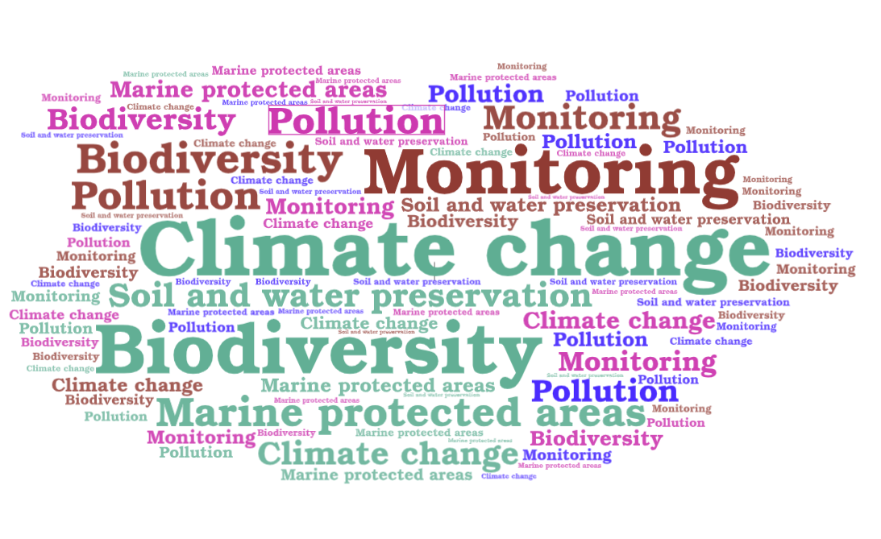
Main topics related to the flagship

Slide 6
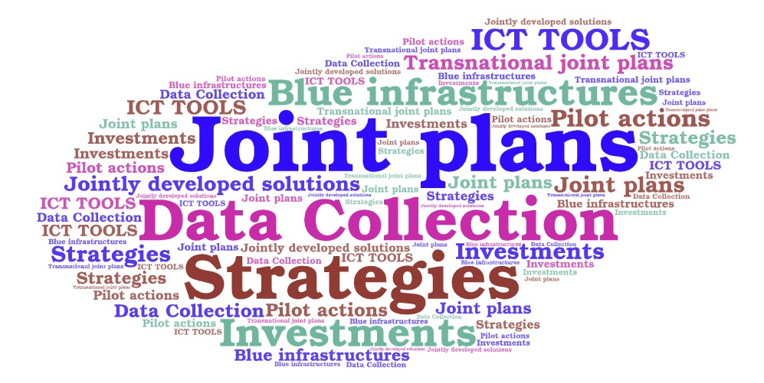
Main outputs linked to the flagship

Slide 7
Embedding EUSAIR in ETC’s implementation:
Let’s start from the call for proposals
1) Embedding EUSAIR in the call for proposals
Assessment criteria
(defined by MC)
The project clearly and consistently contributes to specified EUSAIR macro-regional Strategy objectives and actions
The project objective and activities are explicitly foreseen in the EUSAIR action plan or in the EUSAIR flagships, the project clearly outlines how these activities are going to be followed up on within the EUSAIR
EXAMPLES

Slide 8
EUSAIR ETC Network through the Action Labs
Supporting embedding during Programme implementation
2) Assessing the contribution to EUSAIR
Provide guidance on how to assess (JS) or prepare (potential applicants) a project proposal in line with EUSAIR’s objectives.
3) Strategic and targeted calls dedicated to a specific flagship
Define needs, tools and opportunities to support ETC Programmes

Slide 9
Thank you for your attention!
Battistina Cugusi
Email: b.cugusi@governo.it

